Slide 1


Product Review and Visual Categorization using Deep Learning
Government College of Engineering & Research Avasari Khurd, Savitribai Phule Pune University
Final Year Project, 2024-25 Semester I
Computer Engineering Department
Guide: K.B. Sadafale
Members :
21121036 Aditya Pawar
21121007 Atmaram Kambli
21121004 Swastik Gupta
22221078 Atharva Pawar

Slide 2
Table of Contents
1. Introduction
2. Overall Description
3. External Interface Requirements
4. System Features
5. References

Slide 3
Problem Statement and Motivation
Online platforms have transformed the way consumers make purchasing decisions, with product reviews and accompanying images becoming crucial sources of information. Extracting valuable insights from these vast amounts of data presents a significant challenge. Traditional methods for sentiment analysis and image categorization have limitations in handling complex linguistic patterns and visual features.
The increasing availability of large-scale datasets and advancements in deep learning have opened new avenues for addressing these challenges. By combining natural language processing and computer vision techniques, we can develop sophisticated models capable of understanding the nuances of human language and interpreting visual content.
This research is motivated by the need for a comprehensive approach to analyze product reviews and images. By accurately determining sentiment and categorizing visual content, businesses can gain a deeper understanding of customer preferences, identify product strengths and weaknesses, and make data-driven decisions to improve product offerings and marketing strategies.

Slide 4
Literature Survey
Title | Source and Author | Years | Techniques | Merits | Demerits
Current State of Text Sentiment Analysis from Opinion to Emotion Mining | ACM Computing Surveys; Yadollahi, A. et al. | 2017 | Survey of text-based sentiment analysis techniques | Comprehensive overview from opinion to emotion mining | Focuses only on text, not multimodal
A survey of recent architectures of deep convolutional neural networks. | Artificial Intelligence Review; Khan, A. et al. | 2019 | Survey of deep CNN architectures for image categorization | Detailed review of CNN developments for image analysis | Limited to image modality, doesn't cover text
Deep Residual Learning for Image Recognition. | IEEE CVPR; He, K. et al. | 2015 | ResNet architecture for image categorization | Significant improvement in deep network training for images | Focused solely on image recognition
GLoRIA: A Multimodal Framework | AAAI; Yu Wang, Q.Xing et al. | 2015 | Progressive training and domain image. | Robust approach for image sentiment | Does not incorporate textual data

Slide 5
Objectives
Develop a deep learning model capable of accurately classifying the sentiment expressed in product reviews.
Create a robust image categorization system that can effectively classify product images into predefined visual categories.
Design a multi-modal framework that can jointly analyze product reviews and images to enhance sentiment analysis and image categorization performance.
Evaluate the proposed models on a large-scale dataset to demonstrate their effectiveness and generalizability.
Explore potential applications of the developed models in various domains, such as product recommendation, market research, and customer feedback.

Slide 6
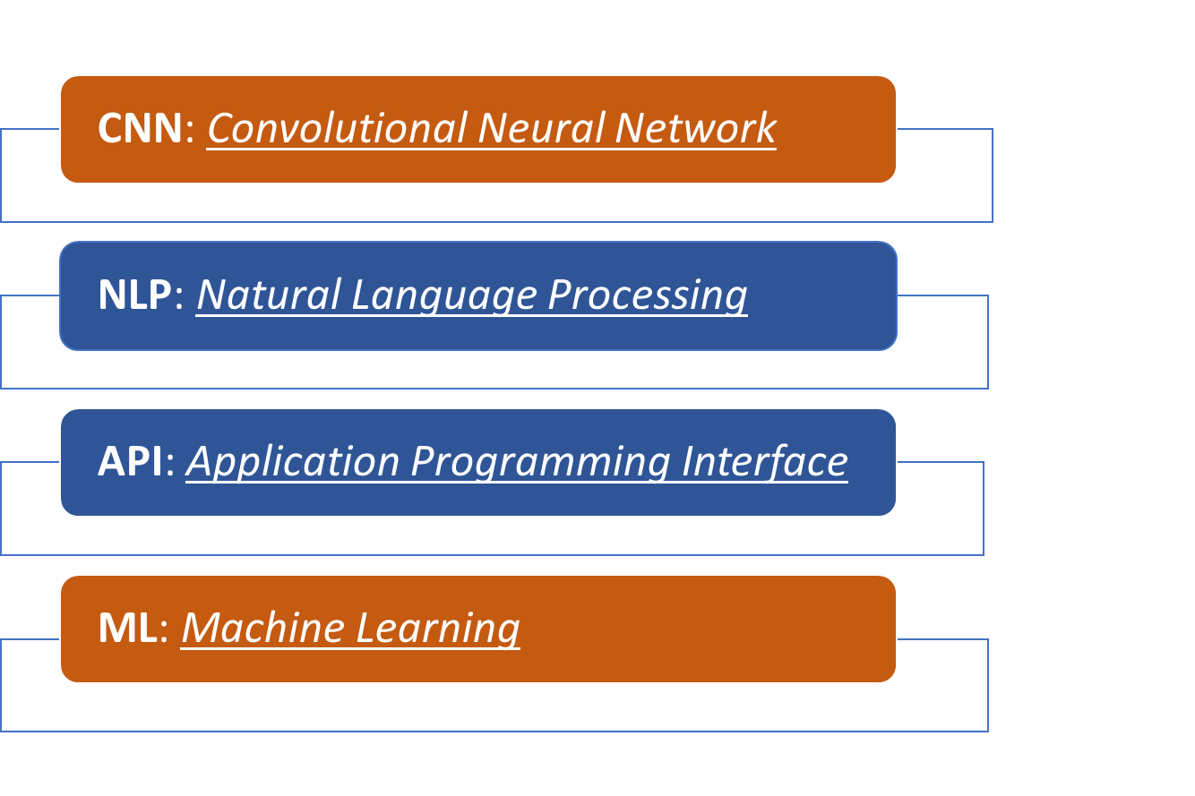
System Requirements and Specifications
Document Conventions:

Slide 7
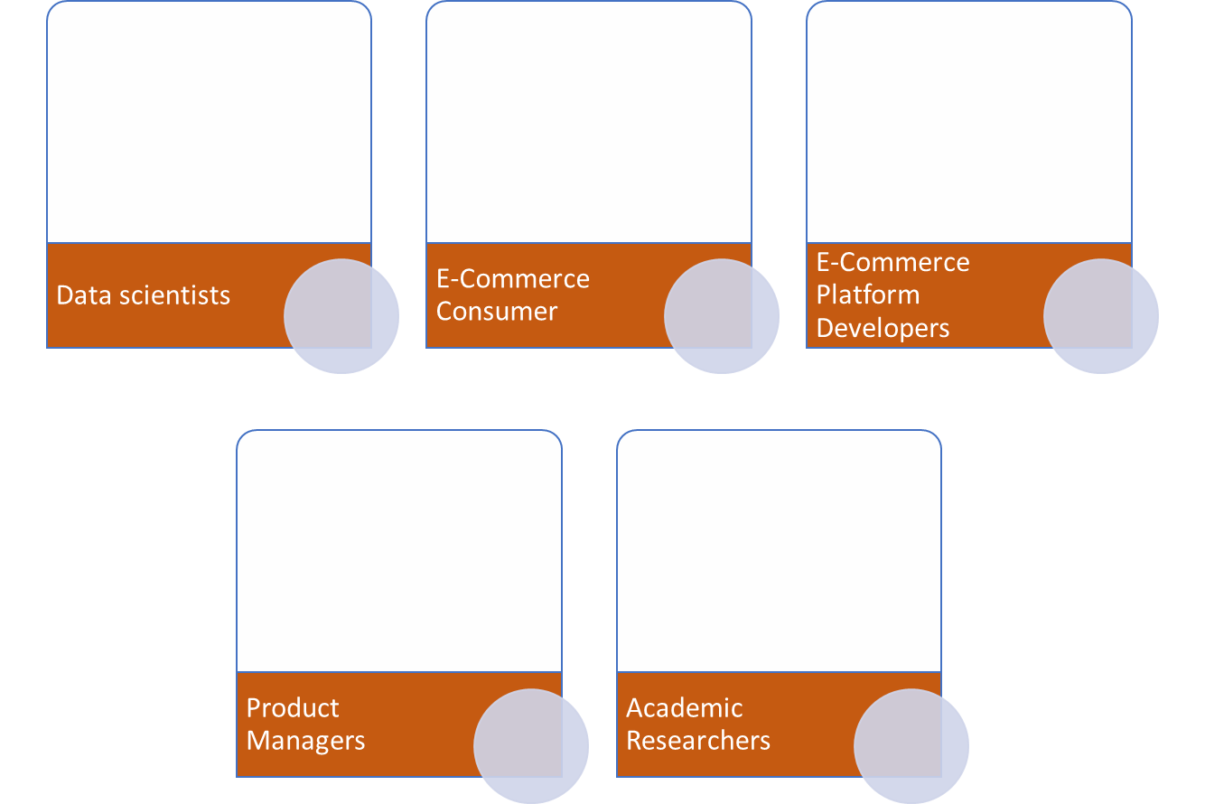





Intended Audience

Slide 8
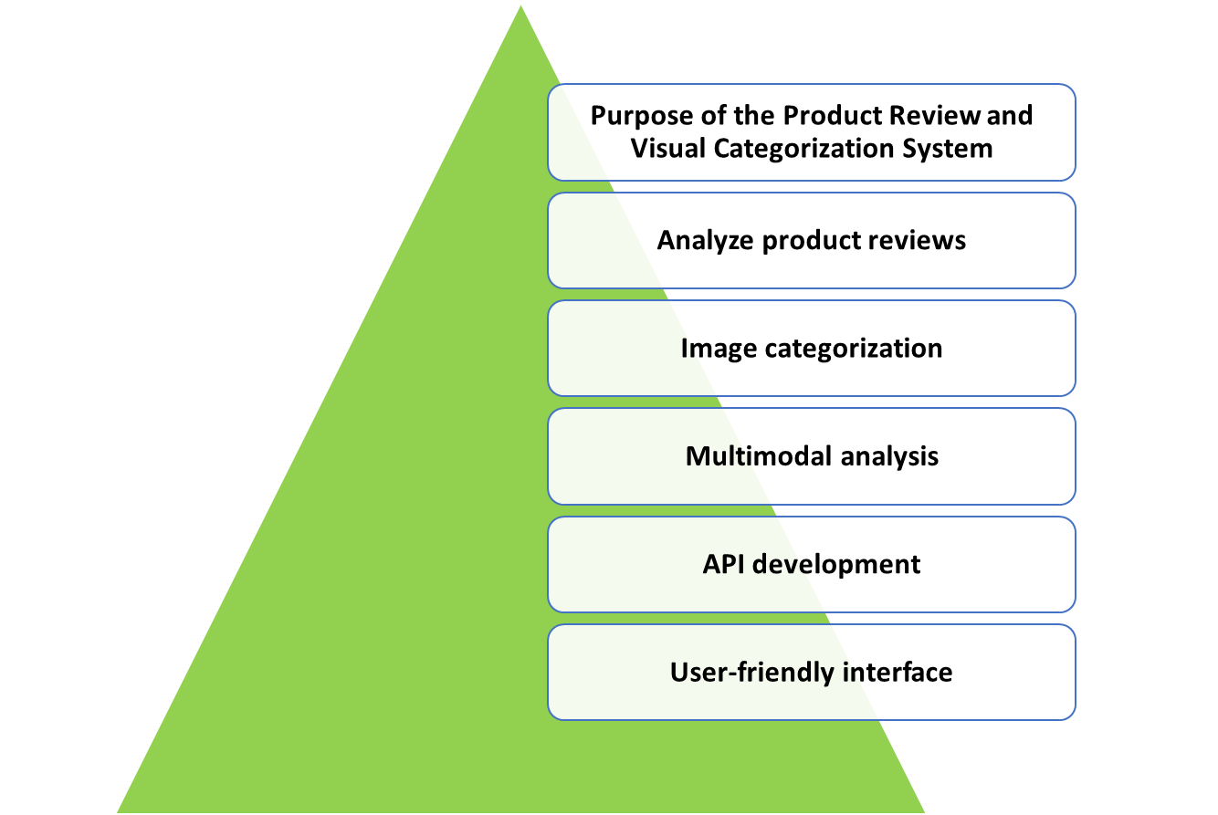
Scope of the Project

Slide 9
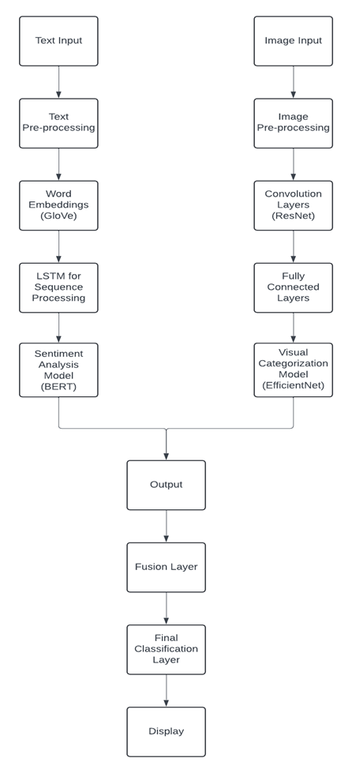

Overall Description
The Product Review and Visual Categorization system uses Deep Learning to analyze product details, reviews, images, and user information for improved product categorization and personalized recommendations.
Product Features: Major features include review sentiment analysis, product categorization, and API integration.

Slide 10
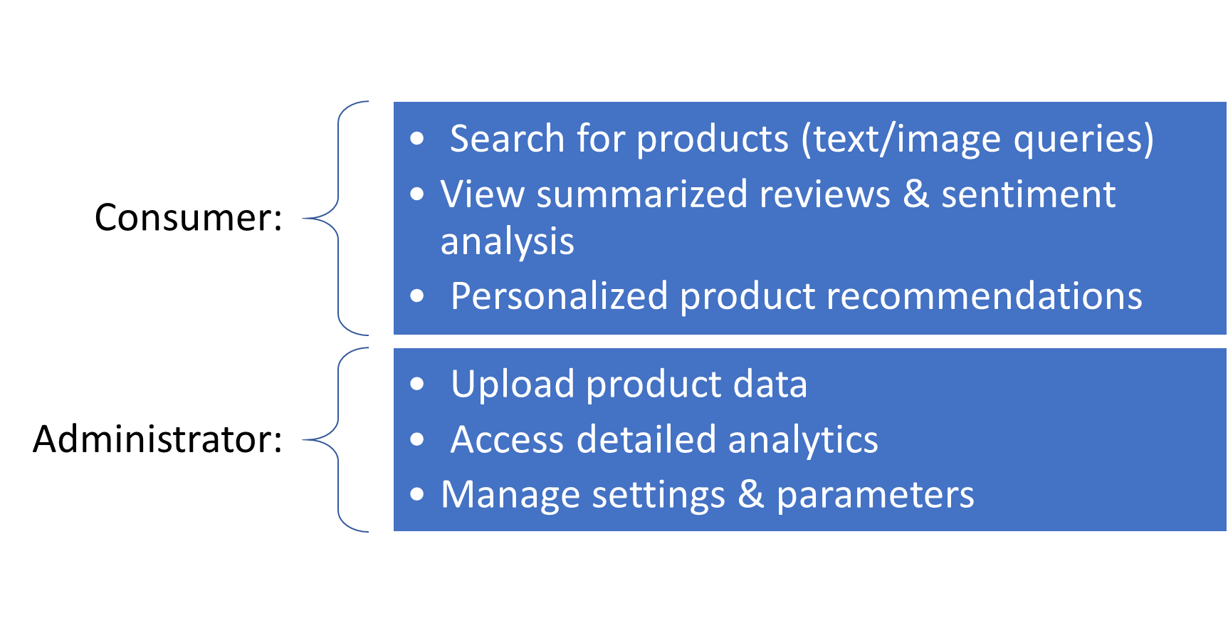
User Classes and Characteristics

Slide 11
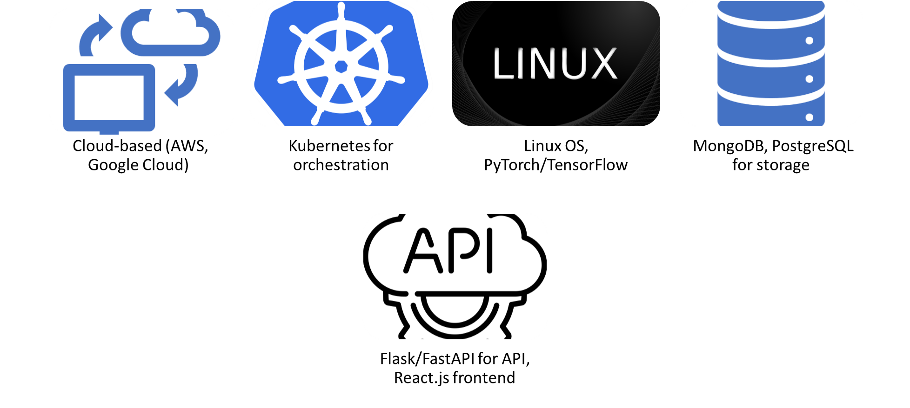
Operating Environment

Slide 12


Design and Constraints
Assumptions and Dependencies
Scalability for millions of products
Real-time processing
Compliance with privacy regulations
API integration with platforms
Regular model retraining
Use in e-commerce & market research
Availability of large datasets
High-performance GPUs for processing
Continuous feed of product/review data
Seamless e-commerce integration

Slide 13
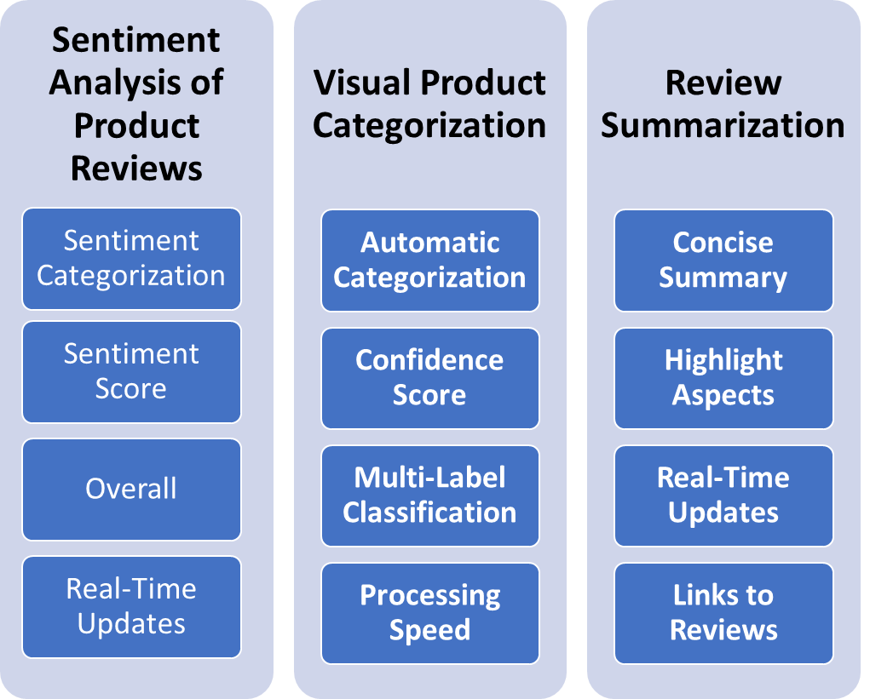
System Features

Slide 14
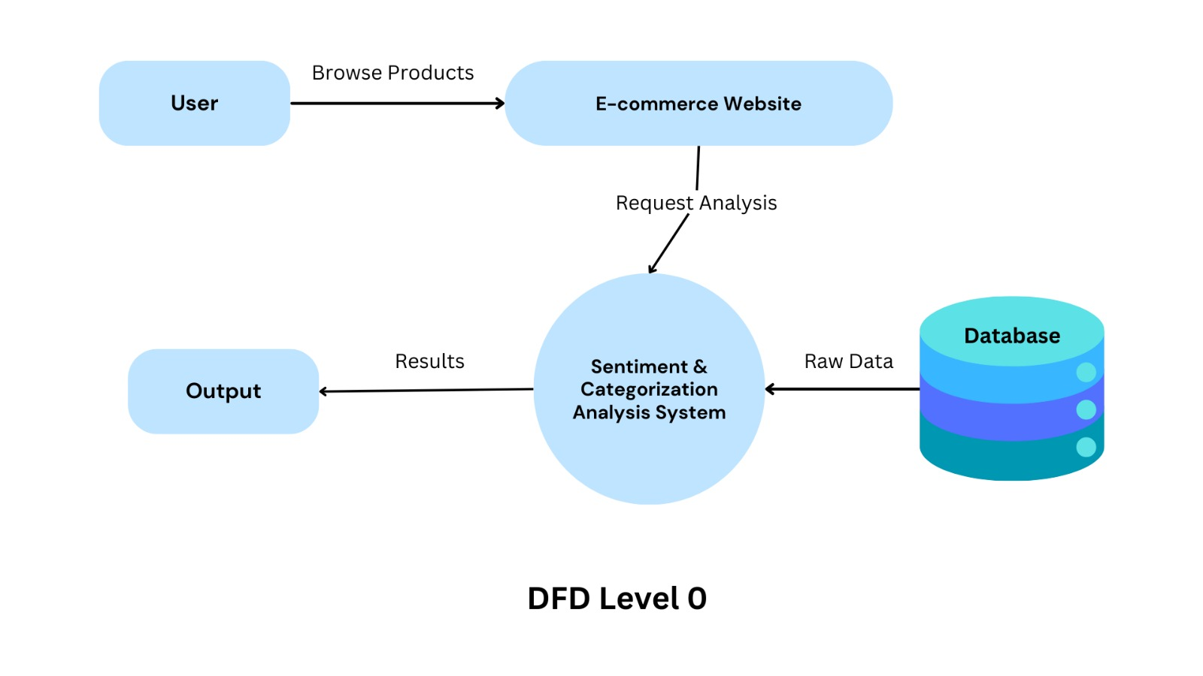
DFD LEVEL 0

Slide 15
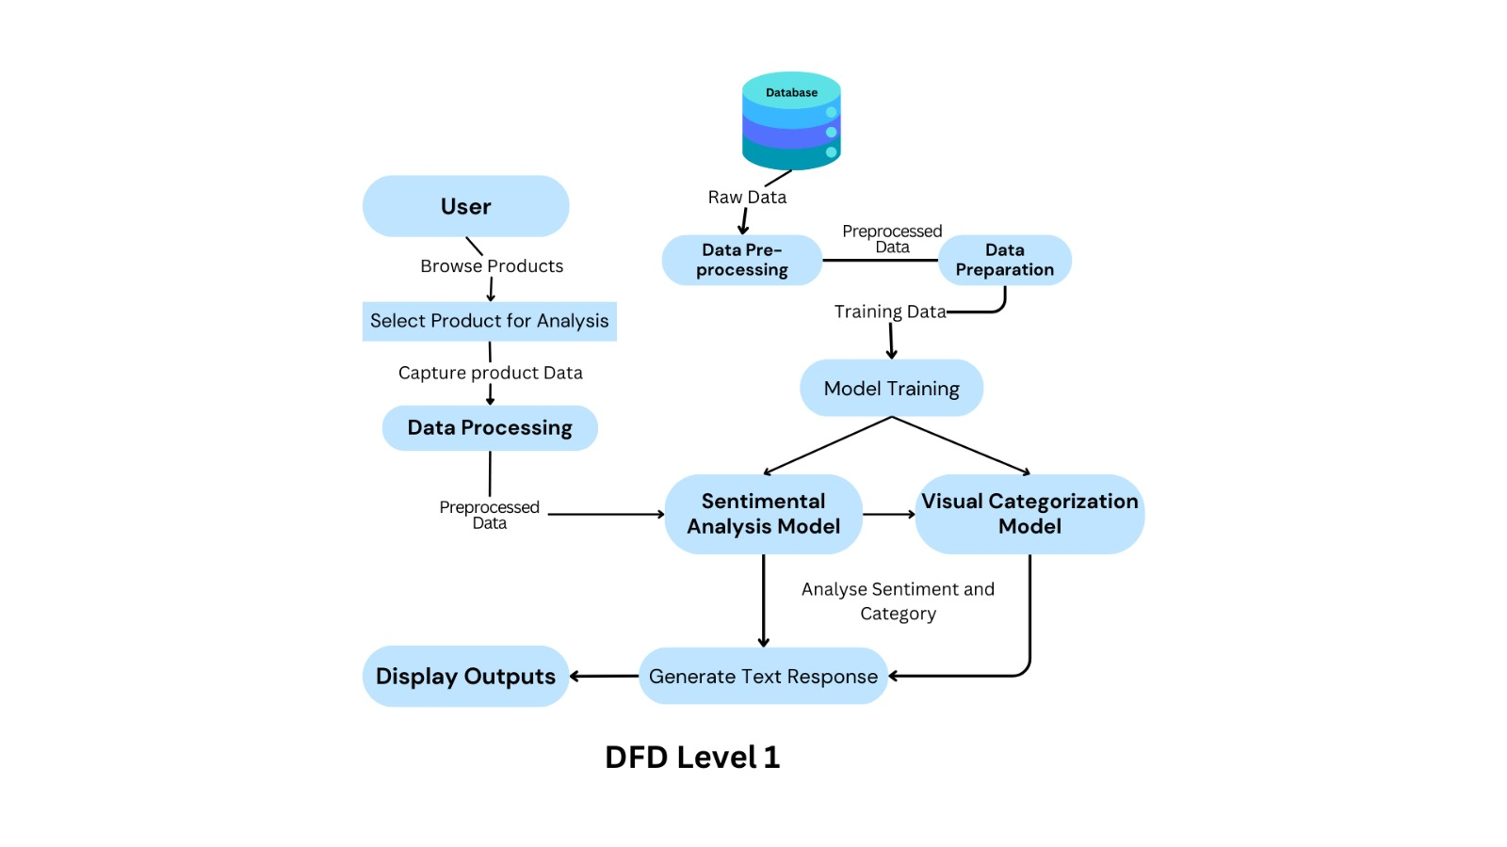

Slide 16
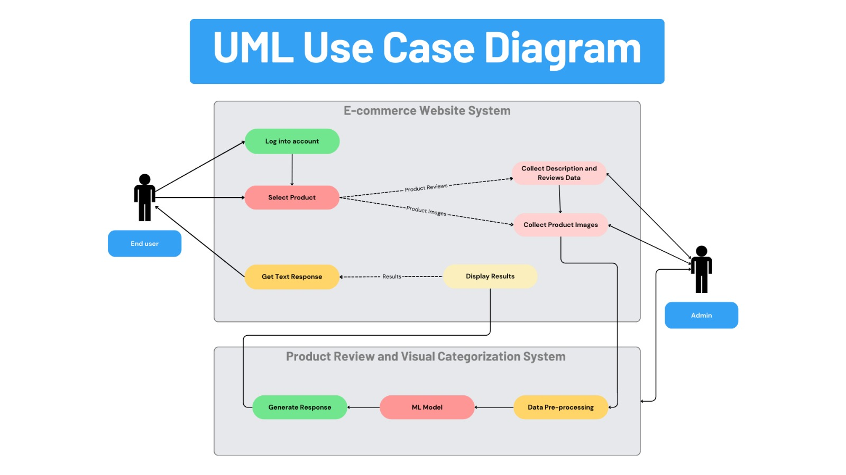

Slide 17
References
References Devlin, J., Chang, M. W., Lee, K., & Toutanova, K. (2019). BERT: Pre-training of Deep Bidirectional Transformers for Language Understanding.
Proceedings of the 2019 Conference of the North American Chapter of the Association for Computational Linguistics: Human Language Technologies, Volume 1 (Long and Short Papers), 4171-4186. https://doi.org/10.18653/v1/N19-1423Zhang, L., Wang, S., & Liu, B. (2018).
Deep learning for sentiment analysis: A survey. Wiley Interdisciplinary Reviews: Data Mining and Knowledge Discovery, 8(4), e1253. https://doi.org/10.1002/widm.1253Vaswani, A., Shazeer, N., Parmar, N., Uszkoreit, J., Jones, L., Gomez, A. N., Kaiser, Ł., & Polosukhin, I. (2017).
Attention is All you Need. Advances in Neural Information Processing Systems, 30, 5998-6008.Liu, Y., Ott, M., Goyal, N., Du, J., Joshi, M., Chen, D., Levy, O., Lewis, M., Zettlemoyer, L., & Stoyanov, V. (2019). RoBERTa: A Robustly Optimized BERT Pretraining Approach. arXiv preprint arXiv:1907.11692.Tan, C., & Celis, L. E. (2019).
Assessing Social and Intersectional Biases in Contextualized Word Representations. Advances in Neural Information Processing Systems, 32, 13230-13241.Zhang, X., Zhao, J., & LeCun, Y. (2015).
Character-level Convolutional Networks for Text Classification. Advances in Neural Information Processing Systems, 28, 649-657.Socher, R., Perelygin, A., Wu, J., Chuang, J., Manning, C. D., Ng, A., & Potts, C. (2013).
Recursive Deep Models for Semantic Compositionality Over a Sentiment Treebank. Proceedings of the 2013 Conference on Empirical Methods in Natural Language Processing, 1631-1642.Mikolov, T., Sutskever, I., Chen, K., Corrado, G. S., & Dean, J. (2013).
Distributed Representations of Words and Phrases and their Compositionality. Advances in Neural Information Processing Systems, 26, 3111-3119.

Slide 18
Thank You!

